Slide 1
Internet Project
Submitted by,
Tushar Chandrashekhar Jakhalekar
Problem Statement:
The web analytics team of www.datadb.com is interested to understand the web activities of the site, which are the sources used to access the website. They have a database that states the keywords of time in page, source group, bounces, exits, unique page views, and visits.
Variables:
Bounces: It represents the percentage of visitors who enter the site and "bounce" (leave the site) rather than continuing to view other pages within the same site.
Exits: It represents the percentage of visitors to a site who actively click away to a different site from a specific page, after possibly having visited any other page on the site.
Continent: It shows the continent from which the site has been accessed.
Source group: It shows how the visitor has accessed the site. - Time on page: It shows how long the user has spent on that particular page of the website.
Unique page view: It represents the number of sessions during which that page was viewed one or more times.
Visits: A visit counts all visitors, no matter how many times the same visitor may have been to your site.

Slide 2
Problem 1 :
The team wants to analyze each variable of the data collected through data summarization to get a basic understanding of the dataset and to prepare for further analysis.
Solution :
Installing the required packages
library(readxl)
To import the .xlsx file
library(dplyr)
For data manipulation
library(caret)
For checking accuracy of the model

Slide 3
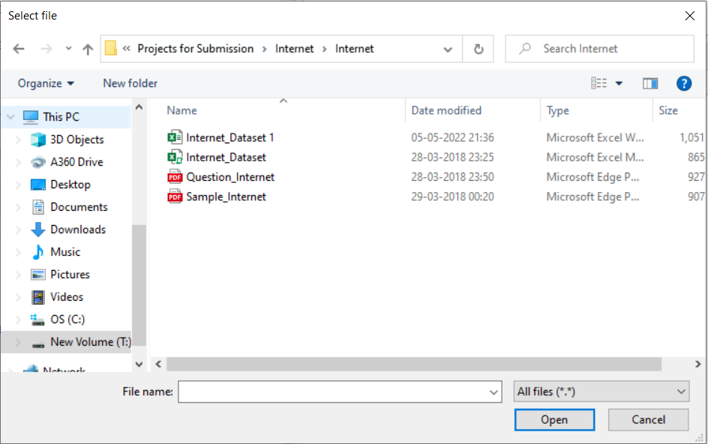
df=read_excel(file.choose())
Selecting the file from system data

Slide 4
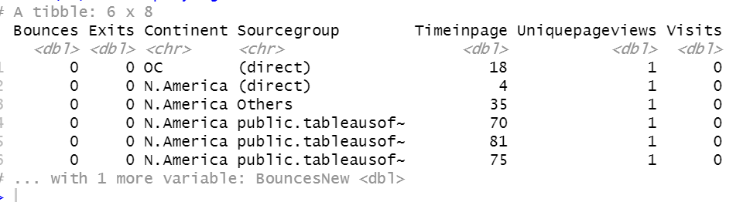
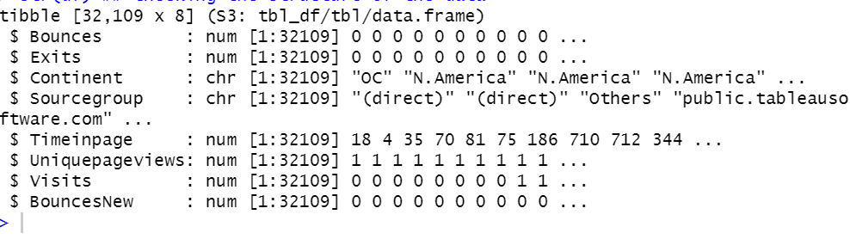
head(df)
Displaying first 6 rows of the data
str(df)
Checking the structure of the data
From this we can say that the data is well structured

Slide 5
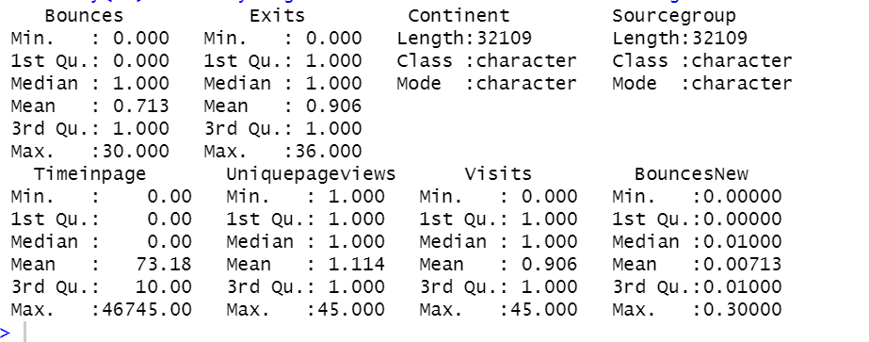
dim(df)
Checking dimensions of the data
From the output we can say that the data has 32109 rows and 8 columns.
summary(df)
Analysing the variables of the data thorough Summarization (Solution)
From the result of summarized dataset, it is observed that the numerical data includes information related to the maximum, minimum, and mean data. The categorical data like continent includes the data of the number of times the category has been repeated in the dataset. We can see that there is a maximum value of 30 bounces for the website. This site was accessed maximum number of times by visitors from North America.

Slide 6
sum(is.na(df))
Checking for Null or NA values
From the result we can see the data has no null or NA values so we can proceed further
library(ggplot2)
Installing library For data Visualization.

Slide 7
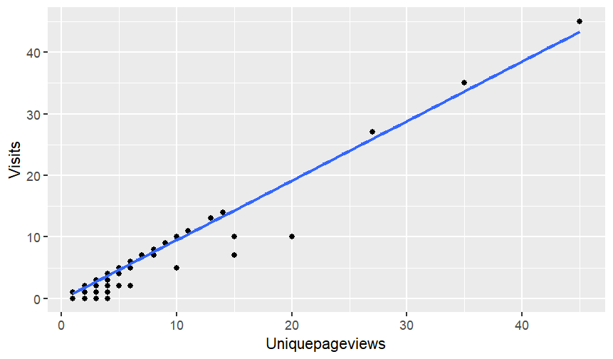
Problem 2 :
As mentioned earlier, a unique page view represents the number of sessions during which that page was viewed one or more times. A visit counts all instances, no matter how many times the same visitor may have been to your site. So the team needs to know whether the unique page view value depends on visits.
ggplot(data=df,aes(x=Uniquepageviews,y=Visits),)+ Visualising the relation between Uniquepagereviews and Visits
geom_point()+
geom_smooth(method=lm,se=FALSE)
Visualising the relation between Uniquepagereviews and Visits
From the graph we can see the relation between Uniquepageviews and Visits
We will proceed further to build linear regression model
H0 = Uniquepagereviews value depends on Visits to the page
H1 = Uniquepagereviews value does not depends on Visits to the page

Slide 8
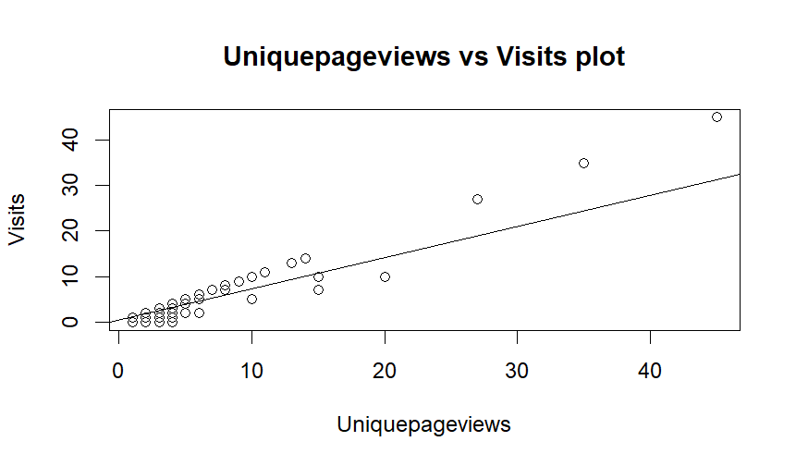
plot(x=df$Uniquepageviews,y=df$Visits,xlab="Uniquepageviews",ylab="Visits",main="Uniquepageviews vs Visits plot")
abline(lm(df$Uniquepageviews~df$Visits))
Similar relationship has been observed after plotting the data
We will proceed to build a linear regression model

Slide 9
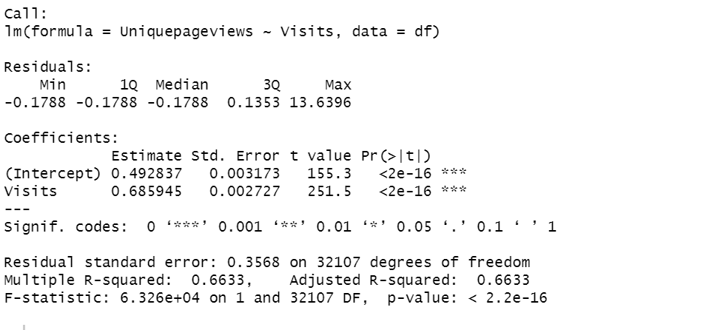
model1=lm(Uniquepageviews~Visits,data=df)
print(model1)
model1$coefficients
Checking model Coefficients
print(summary(model1))
Printing the summary of the model to conclude the result
Results
Call:
lm(formula = Uniquepageviews ~ Visits, data = df)
Coefficients:
(Intercept) Visits
0.4928 0.6859
(Intercept) Visits
0.4928366 0.6859449

Slide 10
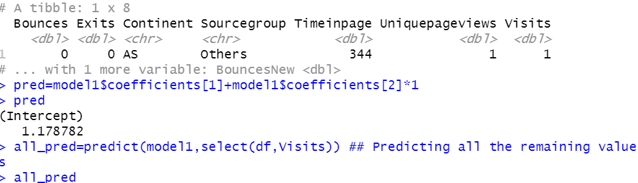
Predicting the remaining values for checking and
Accuracy purpose
df[10,]
Looking for 10th row in the data
pred=model1$coefficients[1]+model1$coefficients[2]*1
Pred
Predicting the value of Unique page views for 10th row
all_pred=predict(model1,select(df,Visits))
Predicting all the remaining values
all_pred
RMSE(df$Uniquepageviews,all_pred)

Slide 11
Result :
As per the observations p-value is less then 0.05 so we are failing to accept the null hypothesis
Hence we conclude that Unique page reviews value does not totally depend on Visits to the website though Visits play some part in determining the Unique page values

Slide 12

Problem 3 :
Find out the probable factors from the dataset, which could affect the exits. Exit Page Analysis is usually required to get an idea about why a user leaves the website for a session and moves on to another one. Please keep in mind that exits should not be confused with bounces.
head(df)
Displaying first 6 rows of the data
Summary(df)
Summarizing the data once again for information purpose
colnames(df)
Checking for column names from the data

Slide 13
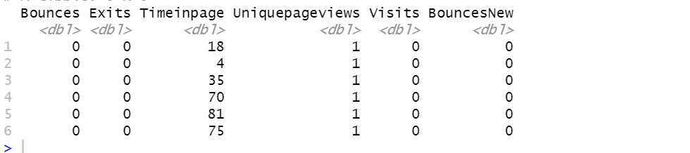
Here we have to check for the probable factors from the dataset, which could affect the exits.
Hence we have to build Logistic regression model. For that purpose we have to remove the columns containing Character values
newdf=df%>%select(-c(Continent,Sourcegroup))
head(newdf)
Our new dataset is ready for building model but we have to convert the data into dataframe.
newdf=as.data.frame(newdf)

Slide 14
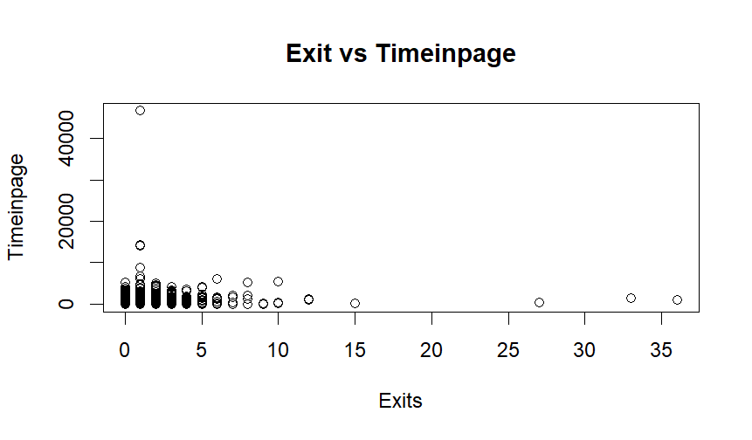
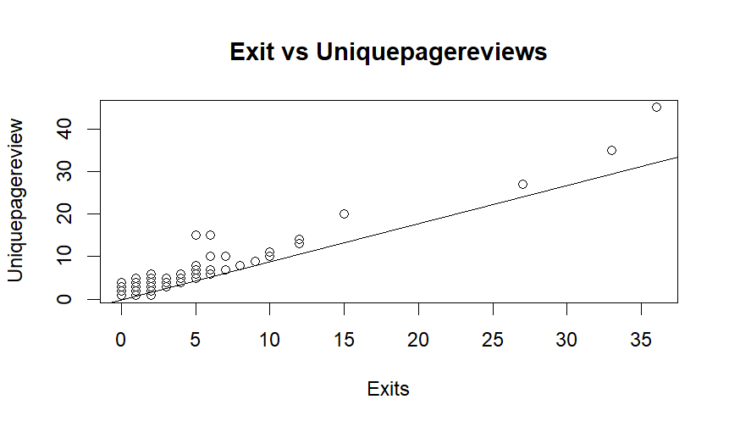
plot(x=newdf$Exits,y=newdf$Timeinpage,xlab="Exits",ylab="Timeinpage",main="Exit vs Timeinpage")
plot(x=newdf$Exits,y=newdf$Uniquepageviews,xlab="Exits",ylab="Uniquepagereview",main="Exit vs Uniquepagereviews")
abline(lm(newdf$Exits~newdf$Uniquepageviews))
We can see there is no a particular pattern in plot for Time in page and Exits
Here there is somewhat linear pattern is observed for Unique page views vs Exits plot

Slide 15
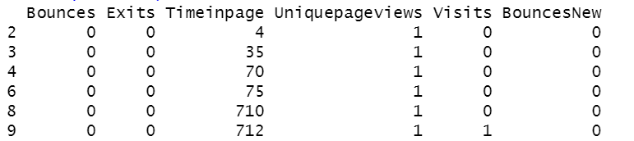
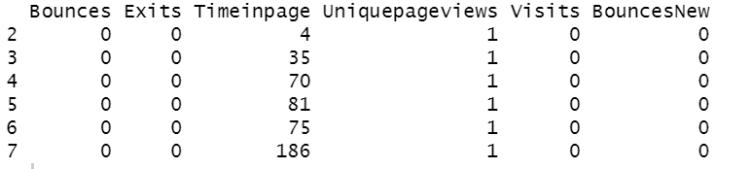
library(caTools)
Installing library for smaple.split function which we need to split the data in 25:75 ratio for cross validation
sampledata=sample.split(newdf,.75)
Creating sampledata by taking 75% of the newdf for training of the model
trainset=newdf[sampledata,]
This will be the dataset used for training of the model
testset=newdf[-sampledata,]
This will be the dataset used for testing of the model
head(trainset)
head(testset)
This clearly indicates that our dataset has split perfectly into two sets

Slide 16
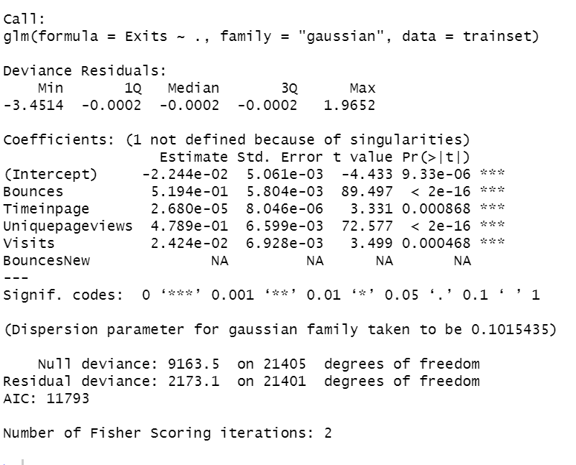
model2=glm(Exits~.,data=trainset,family="gaussian")
Here we have built the Logistic regression model using Training dataset
print(summary(model2))
Printing the summary of model2
Result :
After checking the p-value of the variables we can conclude that Exits value is affected by all the factors in up to some extent
Bounces and unique page views affect Exits value more than the Time in page and Bounces new

Slide 17
Predicting the remaining values using test set and checking accuracy of the model for information purpose
all_pred2=predict(model2,testset)
all_pred2
RMSE(testset$Exits,all_pred2)
RMSE(testset$Exits,all_pred2)
[1] 0.3197071

Slide 18
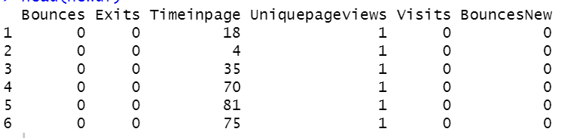
Problem 4 :
Every site wants to increase the time on page for a visitor. This increases the chances of the visitor understanding the site content better and hence there are more chances of a transaction taking place. Find the variables which possibly have an effect on the time on page.
head(newdf)
Now we will try to understand the relationship between time on page and other variables by plotting the points.

Slide 19
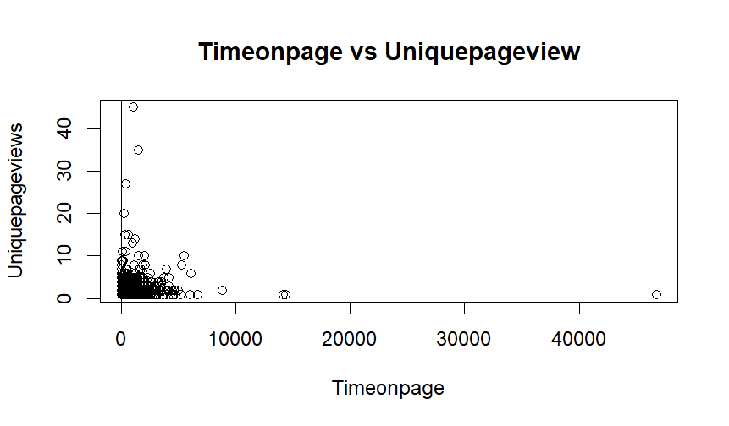
plot(x=newdf$Timeinpage,y=newdf$Uniquepageviews,xlab="Timeonpage",ylab="Uniquepageviews",main="Timeonpage vs Uniquepageview")
abline(glm(newdf$Timeinpage~newdf$Uniquepageviews))
by looking at the plot we can not confirm specific relation between variables
Here we have to check for the variables which possibly have an effect on the time on page.
Hence we will build Logistic regression model.

Slide 20
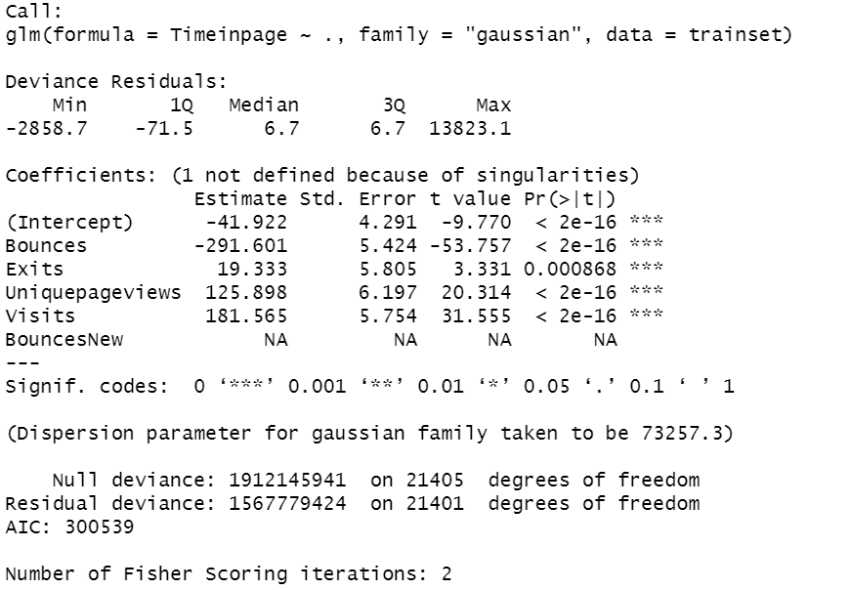
model3=glm(Timeinpage~.,data=trainset,family="gaussian")
We built logistic regression model by using training data set
print(summary(model3))
Result :
By observing the p-values of the variables we can say that Time on page value is affected by all the variables upto some extent.
Time on page value depends on Visits, Unique page view, Vistis more.
Exits value play comparatively less role in determining Time on page.

Slide 21
Predicting the remaining values using testset and checking accuracy of the model for information purpose
all_pred3=predict(model3,testset)
all_pred3
RMSE(testset$Timeinpage,all_pred3)
RMSE(testset$Timeinpage,all_pred3)
[1] 375.398

Slide 22
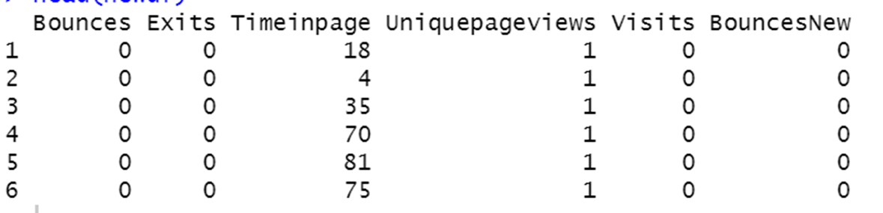
Problem 5 :
A high bounce rate is a cause of alarm for websites which depend on visitor engagement. Help the team in determining the factors that are impacting the bounce.
head(newdf)
Now we will try to understand the relationship between time on page and other variables by plotting the points.

Slide 23
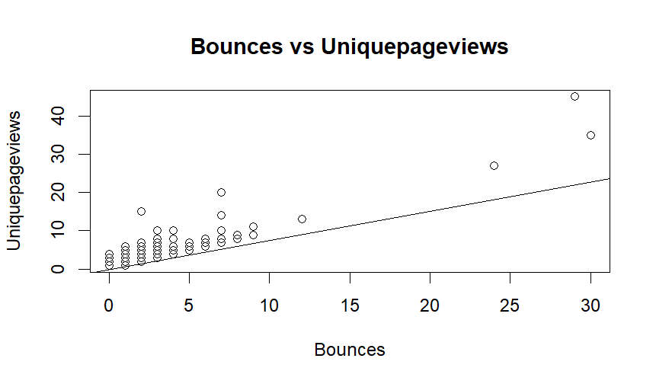
plot(x=newdf$Bounces,y=newdf$Uniquepageviews,xlab="Bounces",ylab="Uniquepageviews",main="Bounces vs Uniquepageviews")
abline(lm(newdf$Bounces~newdf$Uniquepageviews))
by looking at the plot we can not confirm specific relation between variables
Here we have to determine the factors that are impacting the bounce.
Hence we will build Logistic regression model.

Slide 24
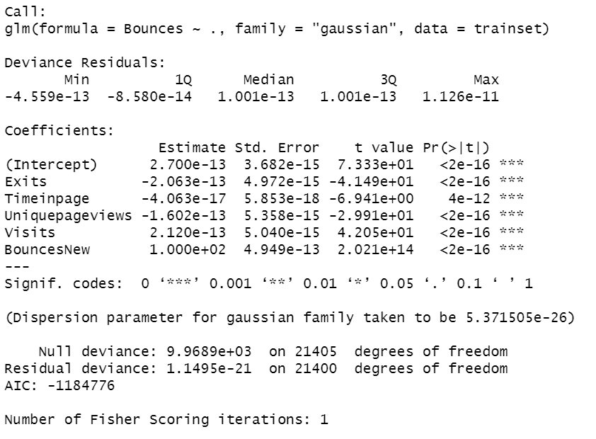
model4=glm(Bounces~.,data=trainset,family="gaussian")
print(summary(model4))
Result :
By observing the p-values we can say that Bounces are affected by all the variables to some extent
Time in page value affects Bounces more than any other variable
Exits, Unique page views, Visits also affects Bounces but to a less extent

Slide 25
Predicting the remaining values using testset and checking accuracy of the model for information purpose
all_pred4=predict(model4,testset)
all_pred4
RMSE(testset$Bounces,all_pred4)
RMSE(testset$Bounces,all_pred4)
[1] 2.453028e-13

Slide 26
Thank You

